Slide 2
SQL Programming
Narasimha
Sr. Corporate Trainer, Mentor
tnrao.trainer@gmail.com

Slide 3
Working with Joins and Sub-Queries
Narasimha
Sr. Corporate Trainer, Mentor
tnrao.trainer@gmail.com

Slide 4
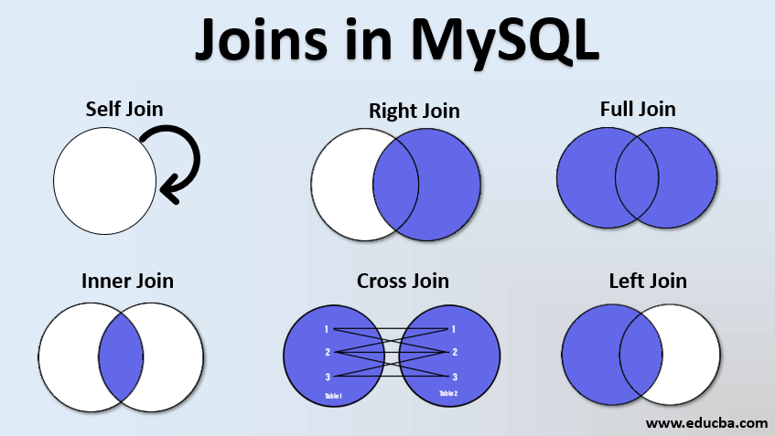

Slide 5
Case Study: Online Bookstore Database
Narasimha
Sr. Corporate Trainer, Mentor
tnrao.trainer@gmail.com

Slide 6
Case Study: Online Bookstore Database
We are working with an online bookstore's database.
The database contains several tables that store information about books, authors, customers, orders, and order details.
Based on these tables we write SQL queries to retrieve specific information using joins and sub-queries.

Slide 7
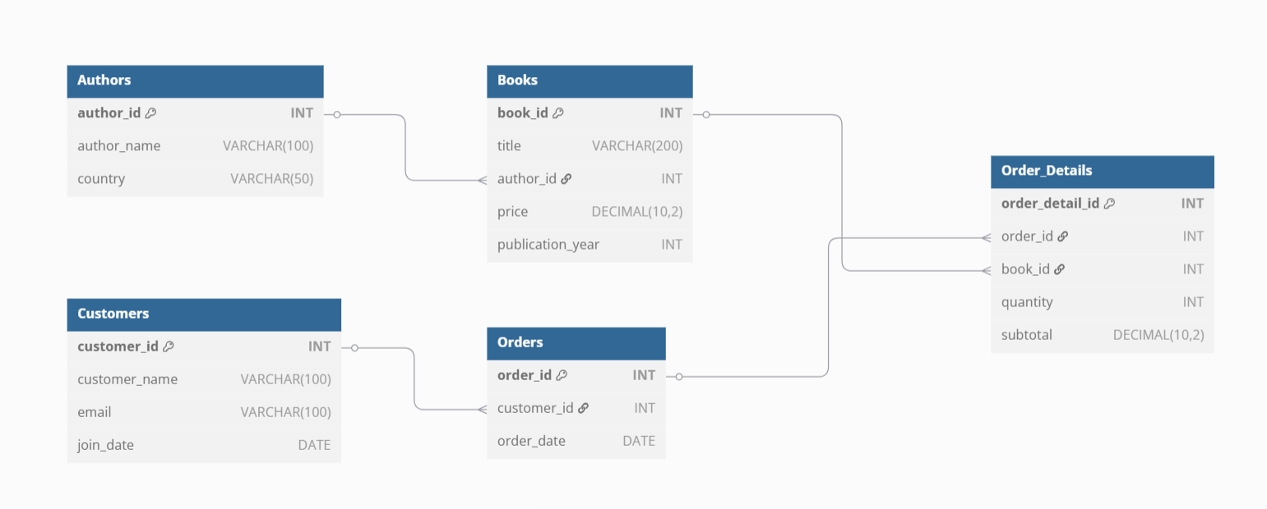
Online Bookstore Database – Database diagram
Notes:
Table Authors {
author_id INT [PK]
author_name VARCHAR(100)
country VARCHAR(50)
}
Table Books {
book_id INT [PK]
title VARCHAR(200)
author_id INT [ref: > Authors.author_id]
price DECIMAL(10, 2)
publication_year INT
}
Table Customers {
customer_id INT [PK]
customer_name VARCHAR(100)
email VARCHAR(100)
join_date DATE
}
Table Orders {
order_id INT [PK]
customer_id INT [ref: > Customers.customer_id]
order_date DATE
}
Table Order_Details {
order_detail_id INT [PK]
order_id INT [ref: > Orders.order_id]
book_id INT [ref: > Books.book_id]
quantity INT
subtotal DECIMAL(10, 2)
}

Slide 8
Retrieve all books along with their author's name and country:
SELECT b.title, a.author_name, a.country
FROM Books b
JOIN Authors a
ON b.author_id = a.author_id;

Slide 9
Find the total revenue generated by each author:
SELECT a.author_name, SUM(od.subtotal) AS total_revenue
FROM Authors a
JOIN Books b ON a.author_id = b.author_id
JOIN Order_Details od ON b.book_id = od.book_id
GROUP BY a.author_name;

Slide 10
List all customers who have placed an order, along with the total amount they have spent:
SELECT c.customer_name, SUM(od.subtotal) AS total_spent
FROM Customers c
JOIN Orders o ON c.customer_id = o.customer_id
JOIN Order_Details od ON o.order_id = od.order_id
GROUP BY c.customer_name;

Slide 11
Find the book with the highest price:
SELECT title, price
FROM Books
WHERE price = (SELECT MAX(price) FROM Books);

Slide 12
Retrieve all books that have never been ordered:
SELECT b.title
FROM Books b
LEFT JOIN Order_Details od ON b.book_id = od.book_id
WHERE od.order_id IS NULL;

Slide 13
Find the customer who has spent the most money:
SELECT TOP 1 c.customer_name, SUM(od.subtotal) AS total_spent
FROM Customers c
JOIN Orders o ON c.customer_id = o.customer_id
JOIN Order_Details od ON o.order_id = od.order_id
GROUP BY c.customer_name
ORDER BY total_spent DESC;

Slide 14
List all authors who have not sold any books:
SELECT a.author_name
FROM Authors a
LEFT JOIN Books b ON a.author_id = b.author_id
LEFT JOIN Order_Details od ON b.book_id = od.book_id
WHERE od.order_id IS NULL;

Slide 15
Find the total number of books sold by each author:
SELECT a.author_name, SUM(od.quantity) AS total_books_sold
FROM Authors a
JOIN Books b ON a.author_id = b.author_id
JOIN Order_Details od ON b.book_id = od.book_id
GROUP BY a.author_name;

Slide 16
Retrieve the details of the most recent order, including the customer's name and the books ordered:
SELECT c.customer_name, b.title, od.quantity, od.subtotal
FROM Orders o
JOIN Customers c ON o.customer_id = c.customer_id
JOIN Order_Details od ON o.order_id = od.order_id
JOIN Books b ON od.book_id = b.book_id
WHERE o.order_date = (SELECT MAX(order_date) FROM Orders);

Slide 17
Find the average price of books published each year:
SELECT publication_year, AVG(price) AS average_price
FROM Books
GROUP BY publication_year;

Slide 18

Q & A

